Slide 1
Digital Explorer Workspaces

Slide 2
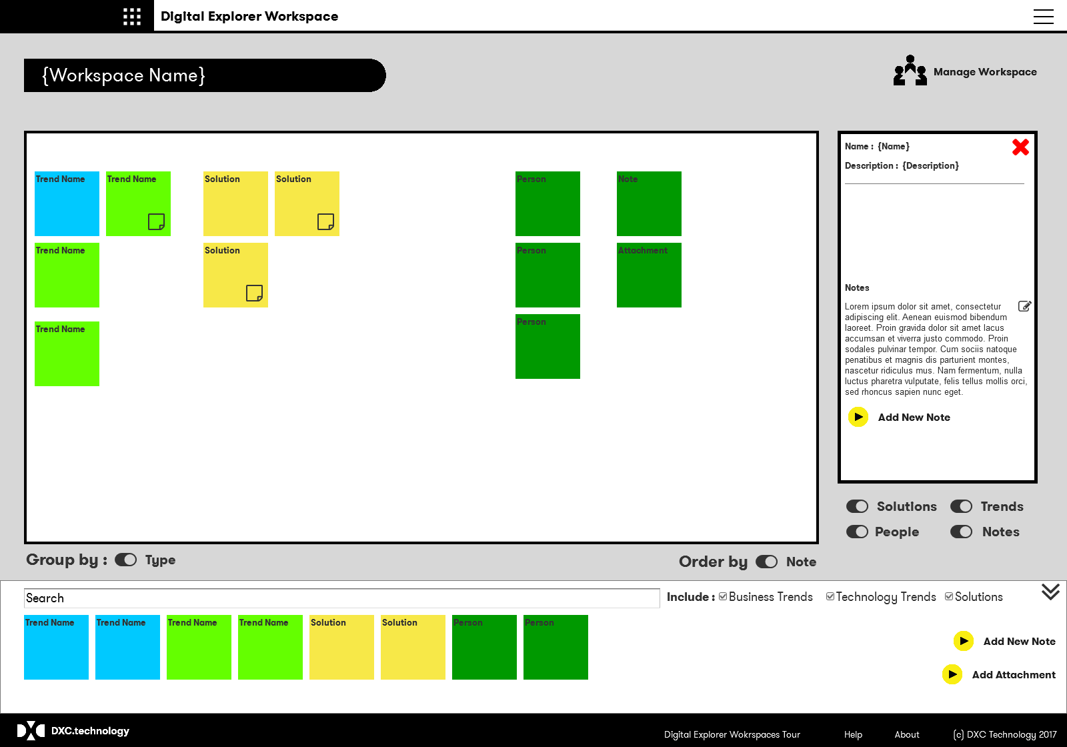
Workspaces
Track, discuss and develop viewpoints for a given area during client engagements or projects
Leverage the existing trend and solution information from Digital Explorer
Add directly from Digital Explorer or within the workspace
Add your own notes and media
Invite and Share with colleagues

